Slide 1


NEXTGEN LIBRARY PORTAL
By Amitha, Vidya and Deekshitha

Slide 2

OVERVIEW
Objectives
Problem Statement
Introduction
Requirements
System Architecture
Project Flow
Backend
Frontend
API integration
Core Concepts Used
Classes and Methods
Design
CLI Menu
Key Features
Future Enhancements
Conclusion
Abstract

Slide 3
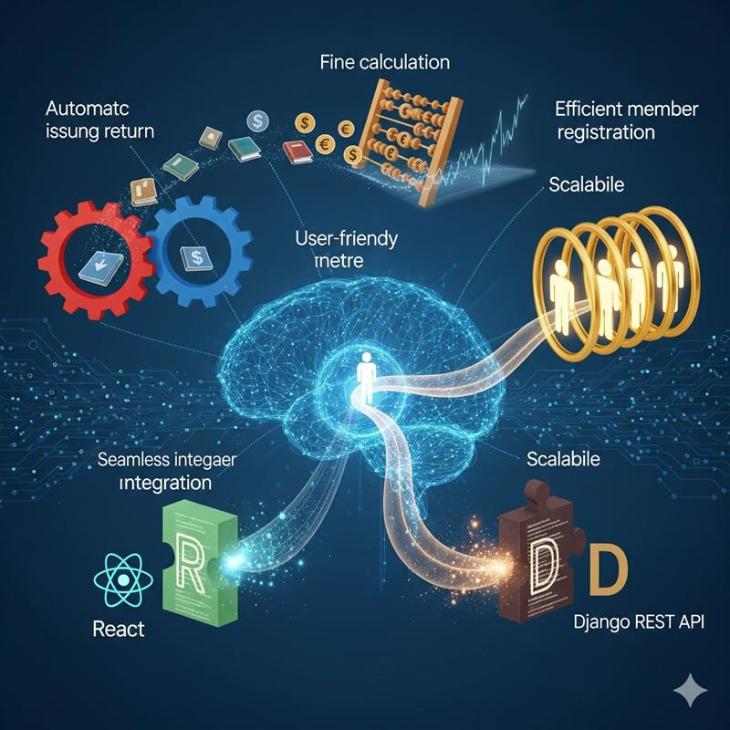
OBJECTIVES
1)To design and implement a digital library management system.
2)To automate book issuing, returning, and fine calculation.
3)To enable efficient member registration and tracking.
4)To provide a scalable and user-friendly web interface.
5)To integrate frontend (React) and backend (Django REST API) seamlessly.

Slide 4
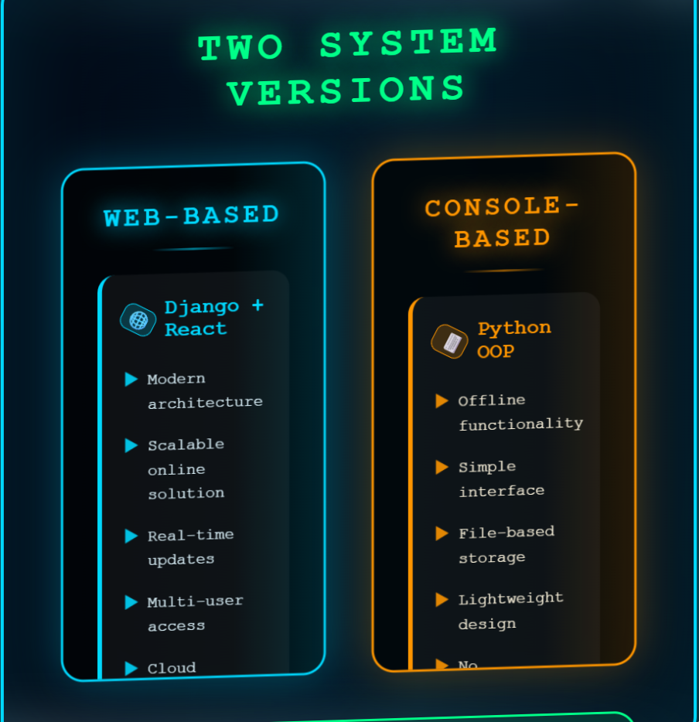
ABSTRACT
Two versions of the system:
Web-based (Django + React) :
modern, scalable online solution
Console-based (Python OOP) :
offline, simple, file-based storage
Both provide efficient, accurate, and automated library management.

Slide 5

PROBLEM STATEMENT
In many libraries, managing books and members is still done manually or with very basic tools.
This often creates problems like books getting misplaced, due dates being missed, or members not being tracked properly.
Students and faculty have different borrowing needs, but most manual systems don’t handle those rules well.
Also, when data isn’t stored properly, all records are lost once the system is closed. This leads to confusion, errors, and extra work for library staff.

Slide 6

INTRODUCTION
The NextGen Library Management System is a web-based application designed to simplify library operations where Python used for backend via Django.
Developed using Django REST Framework (backend) and React (frontend).
Supports book management, member registration, borrowing, and returning of books.
Automates fine calculation and enforces loan rules for members.

Slide 7
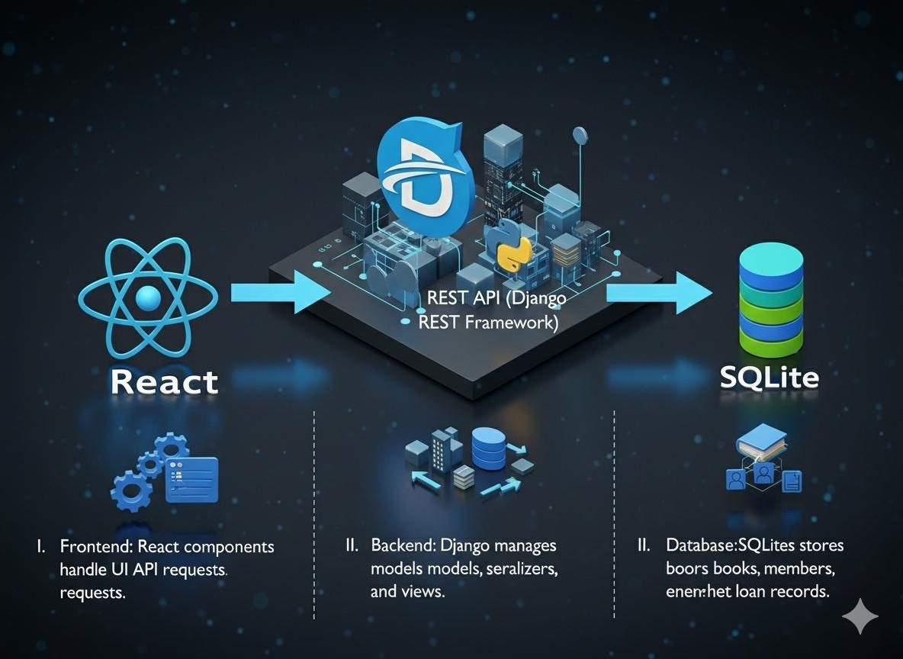
SYSTEM ARCHITECTURE
Frontend (React) ⇄ REST API (Django REST Framework) ⇄ Database (SQLite)
I. Frontend: React components handle UI and API requests.
II. Backend: Django manages models, serializers, and views.
III. Database: SQLite stores books, members, and loan records.

Slide 8
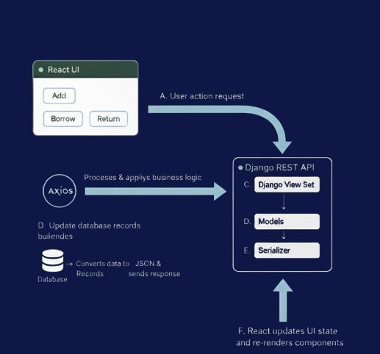
PROJECT FLOW
User action in React UI (Add, Borrow, Return).
Axios sends request to Django REST API.
Django View Set processes request & applies business logic.
Models update database records.
Serializer converts data to JSON and sends response.
React updates UI state and re-renders components.

Slide 9





A
BACKEND MODULES
Book Model
Member Model:
Loan Model
Serializers
View Sets
book_id
title
author
isbn
availability.
member_id,
name,
type (student/faculty).
issue_date,
due_date,
return_date,
fine calculation.
Convert data between Django models and JSON.
CRUD operations + custom borrow/return logic.

Slide 10
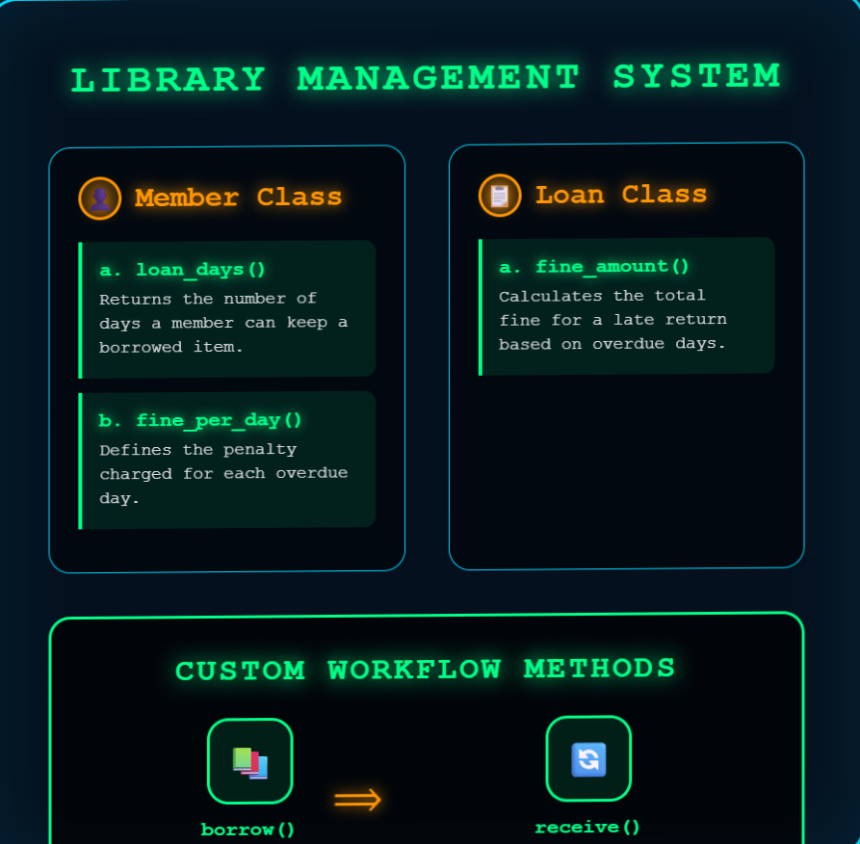
BACKEND METHODS
In Member:
loan_days() => Returns the number of days a member can keep a borrowed item.
fine_per_day() => Defines the penalty charged for each overdue day.
In Loan:
fine_amount() => Calculates the total fine for a late return.
In custom methods:
borrow() =>Allows a member to borrow a book or resource.
receive() => Handles returning of the borrowed item back to the library.

Slide 11
VIEWS
02
MemberViewSet
04
Manages member details like registration and updates.
01
03
BookViewSet
LoanViewSet
Handles all CRUD operations
related to books
Tracks loan transactions between members and books.

Slide 12
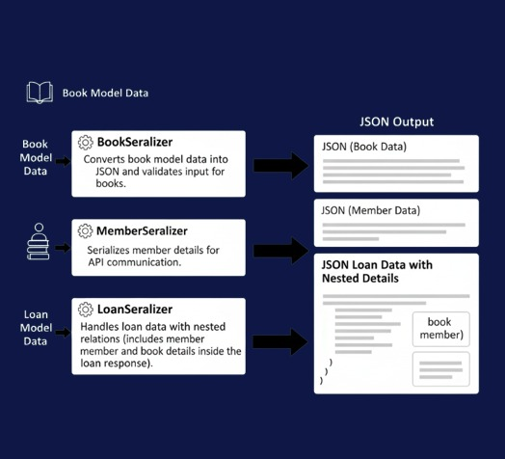
SERIALIZATIONS
BookSerializer : Converts book model data into JSON and validates input for books.
MemberSerializer : Serializes member details for API communication.
c. LoanSerializer : Handles loan data with nested relations (includes member and book details inside the loan response).

Slide 13
FRONTEND MAIN COMPONENTS
02
04
BookList.js
BorrowList.js
Used to manage books (view, add, edit, delete).
Manages borrow and return actions for books.
01
03
App.js
MemberList.js
Acts as the root component and central hub of the application
Handles members and loan management

Slide 14
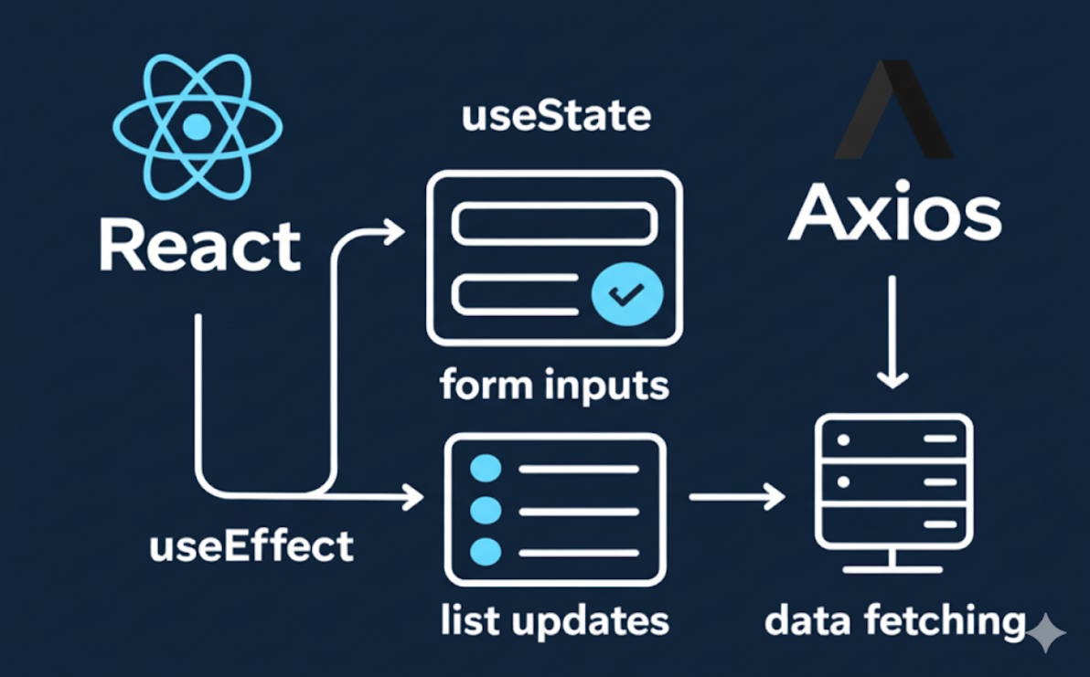
HOOKS AND STATES
useState:
for form inputs and list updates
useEffect:
to fetch data
API:
calls via Axios

Slide 15
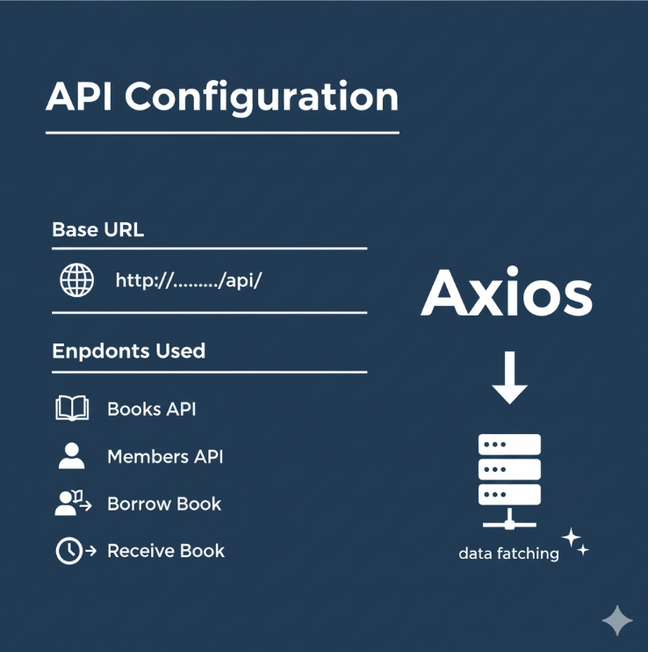
API INTEGRATION
Axios baseURL : http://localhost:8000/api/
Endpoints used:
GET/POST /books/
GET/POST /members/
POST /members/:id/borrow/
POST /members/:id/receive/

Slide 16

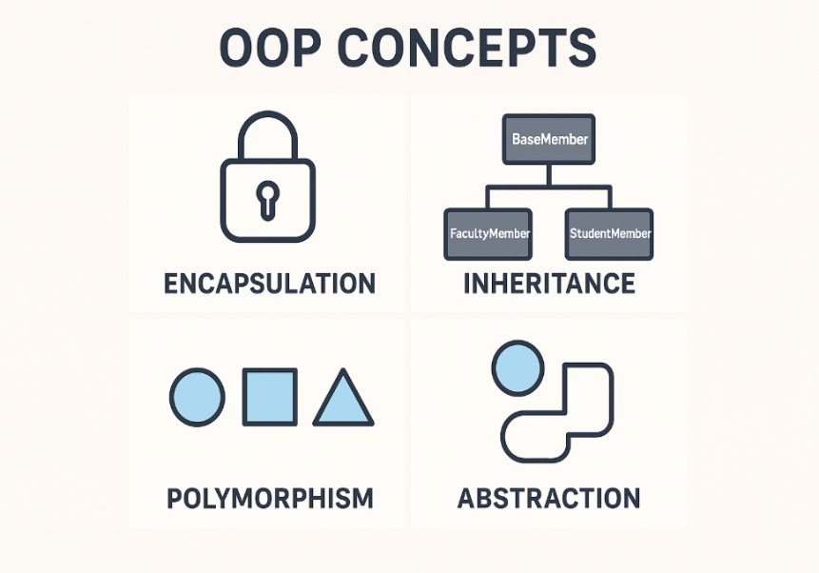
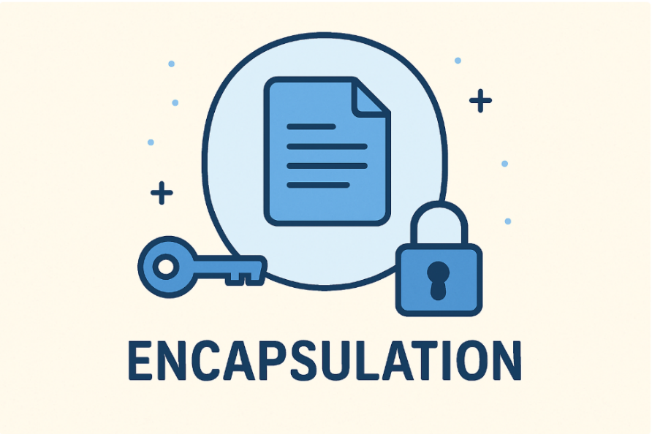
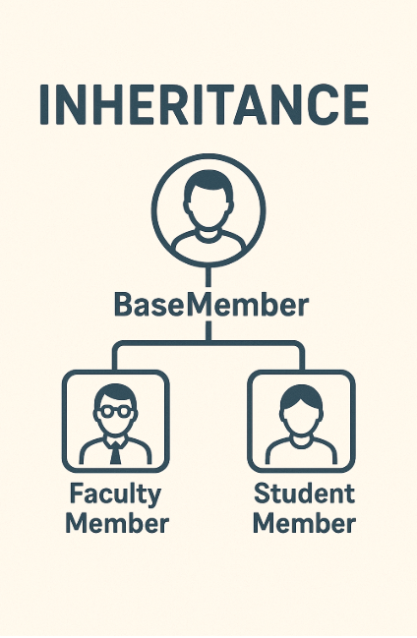
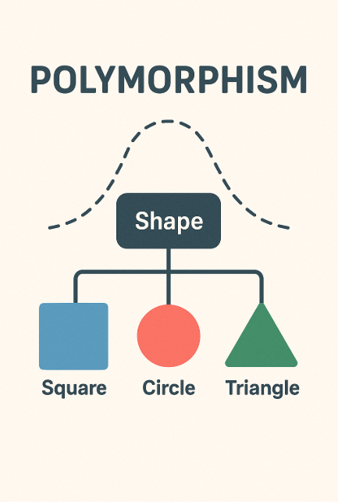
CORE CONCEPTS USED
Object-Oriented Programming (OOP):
Encapsulation:
Inheritance:
Polymorphism:
The system is built around classes like Book, Member, and LibraryPortal.
Each class represents a real-world entity, making the program more modular and easier to manage.
Member details and borrowed books are kept private inside the class.
They can only be accessed or modified through methods, ensuring data security and correctness
Common features are defined in a BaseMember class, while StudentMember and FacultyMember inherit from it.
This avoids duplicate code and allows each type of member to follow their own borrowing rules
The same action (like borrowing a book) works differently depending on whether the user is a student or faculty, thanks to method overriding.

Slide 17
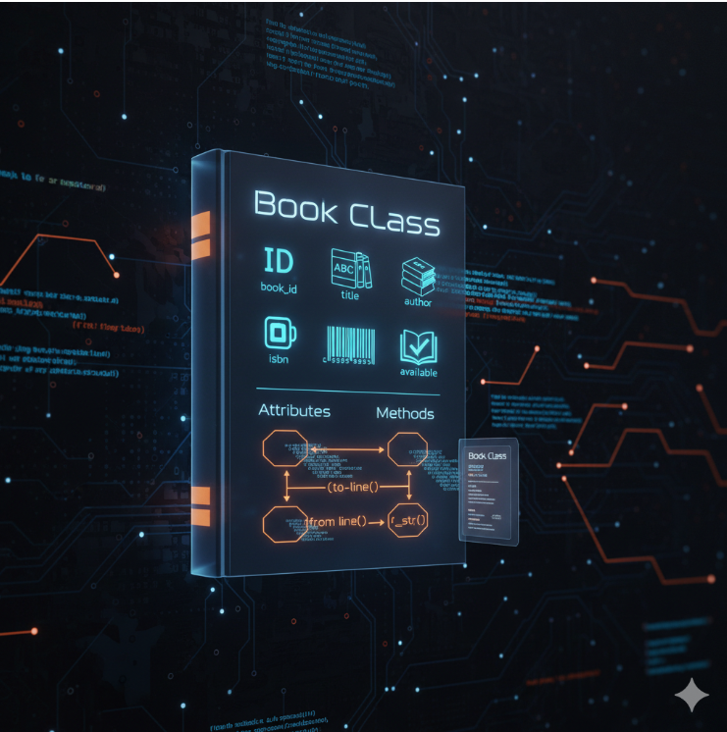
CLASSES AND METHODS
Book Class Attributes: book_id, title, author, isbn, available Methods: to_line(): Converts book details into a text line for saving. from_line(line): Reads a line from file and reconstructs a Book object. __str__(): Displays book details in human-readable format.

Slide 18
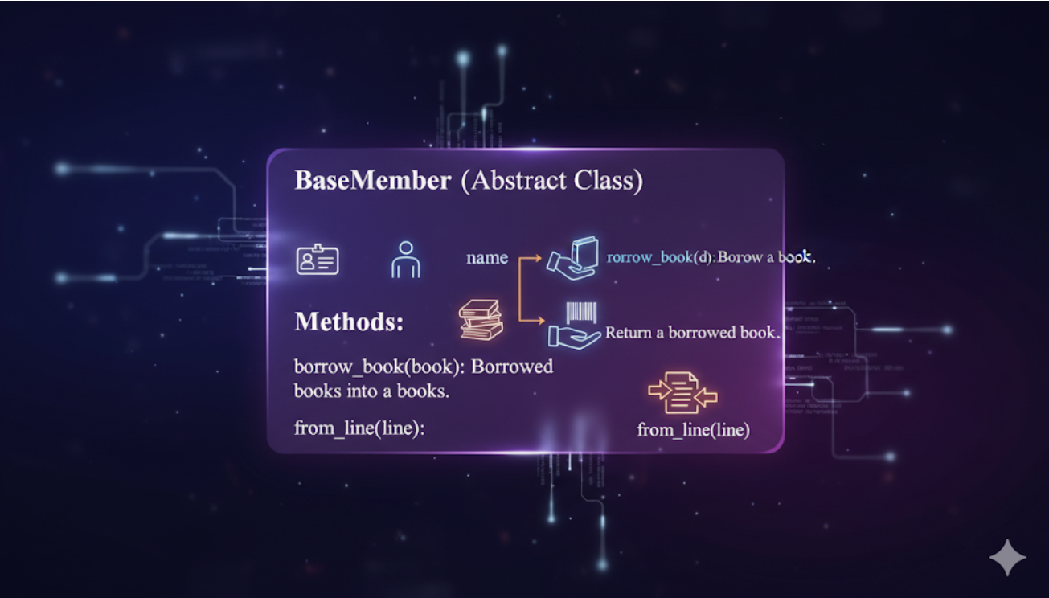
BaseMember (Abstract Class)
Attributes:
member_id, name, __borrowed (list of borrowed books)
Methods: borrow_book(book): Borrow a book. return_book(book_id): Return a borrowed book. to_line(): Save member and borrowed books into a text line. from_line(line): Load member details back from file.

Slide 19
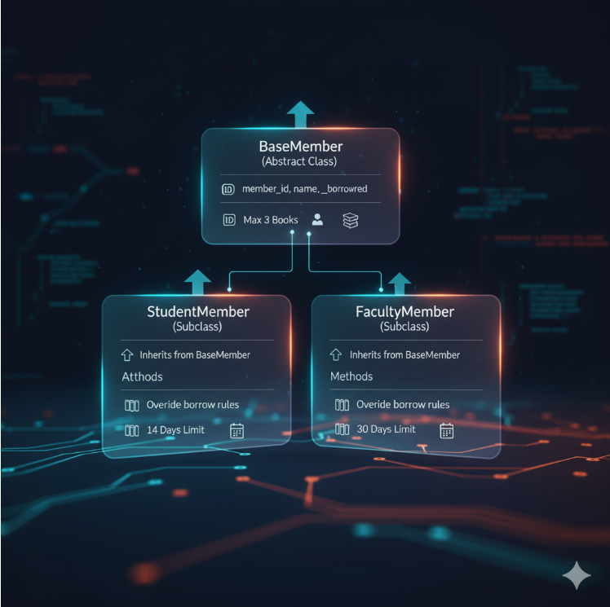
StudentMember (Subclass of BaseMember) Attributes: Inherits from BaseMember Methods: Override borrow rules (max 3 books, 14 days limit).
FacultyMember (Subclass of BaseMember) Attributes: Inherits from BaseMember Methods: Override borrow rules (max 5 books, 30 days limit).

Slide 20
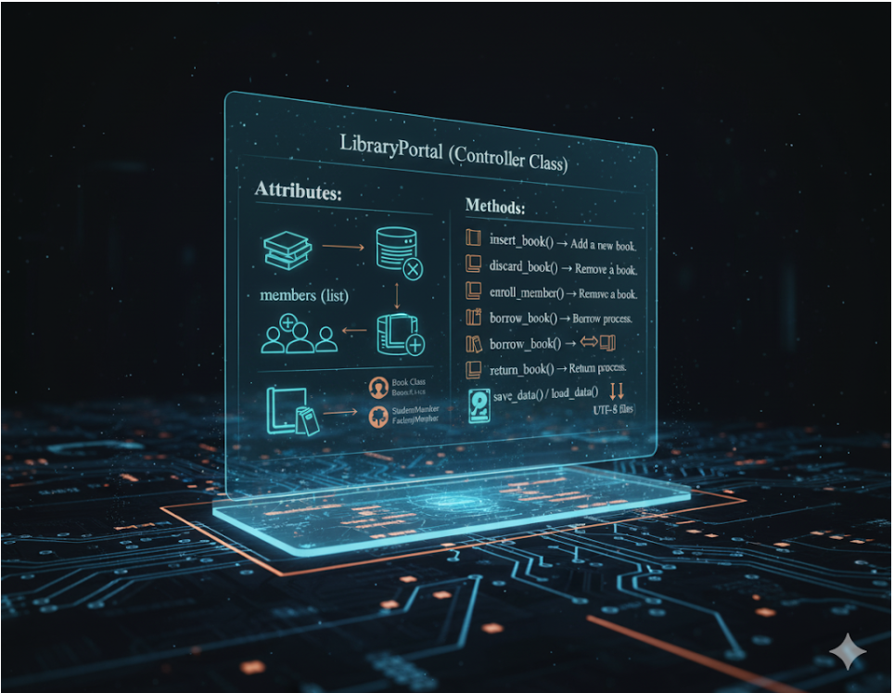
LibraryPortal (Controller Class) Attributes: books (list), members (list) Methods: insert_book() → Add a new book. discard_book() → Remove a book. enroll_member() → Add a new member. borrow_book() → Borrow process. return_book() → Return process. save_data() / load_data() → Persist data in UTF-8 files

Slide 21
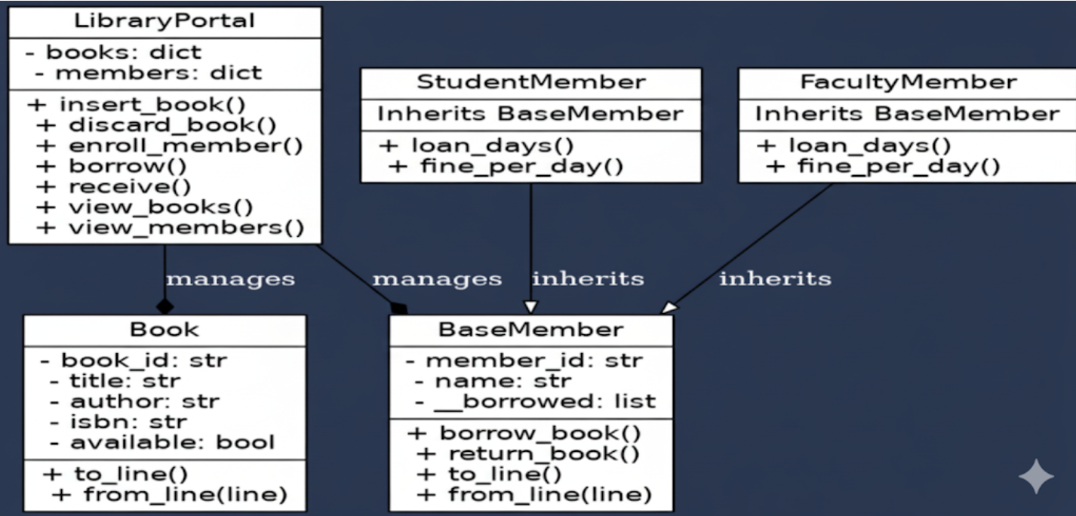
DESIGN

Slide 22
Book Class → Represents books in the system.
BaseMember Class → Abstract parent class.
StudentMember / FacultyMember → Inherit from BaseMember.
LibraryPortal → Manages books and members (composition relationship).

Slide 23
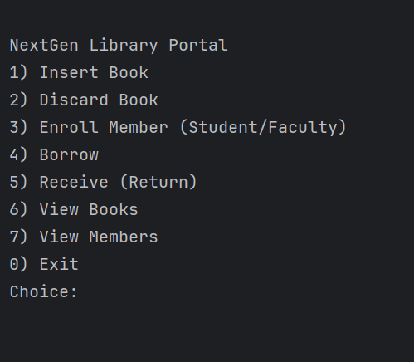
CLI MENU
Insert Book → Add a new book with ID, title, author, and ISBN.
1
Discard Book → Remove a book from the catalog (only if not borrowed).
2
Enroll Member → Register a new student or faculty member.
3
Borrow Book → Issue a book to a member and set the due date.
4
Return Book → Return a borrowed book and calculate fine if overdue.
5
View All Books → Display the list of all books with availability status.
6
View All Members → Display all registered members with their borrowed books.
7
Exit → Close the application.
8

Slide 24





A
KEY FEATURES
Book management (add, view, delete, availability).
Member management with loan rules.
Borrow & return system with automatic fine calculation.
React-based modern UI with real-time updates.
Seamless integration between frontend and backend.

Slide 25
ADVANTAGES
Streamlined Library Operations
Dual Implementation Options
Educational & Developer-Friendly
User-Friendly & Interactive UI
Offline Access & Portability
Scalable & Future-Ready

Slide 26
FUTURE ENHANCEMENTS
User authentication (admin, librarian, members).
Reports and analytics (overdue books, fines collected).
Enhanced UI/UX with validations and error handling.
Deployment on Docker and Cloud hosting

Slide 27
CONCLUSION
Developed a full-stack web-based library management system.
Hands-on experience with Django REST Framework and React.
Successfully integrated backend and frontend via REST APIs.
Implemented real-world features like borrowing, returning, and fines.
Built a scalable foundation for future improvements.

Slide 28
THANK YOU

